Slide 1
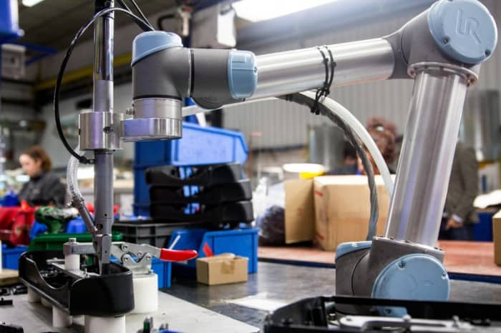

CSC485B Machine Learning for Robotics
SUNY Plattsburgh
Dr. Ned Lecky
Class 04- Neural Networks as Generalized Linear Regression

Slide 2
Today
We saw using sklearn for Linear Regression, Decision Trees, and JUST BARELY neural networks last time
Let’s learn more about neural networks

Slide 3
Regression
X
F
Y
Recall: regression is just taking one or more input variables and using them to predict one or more output variables (SISO, MISO, MIMO)
Super Useful! MUCH mathematical theory BUT
The bulk of the theory assumes LINEAR equations
Much theory also assumes that the input variables are independent

Slide 4
Linear Regression
INSERT DIAG 1

Slide 5
Generalizing for MIMO
INSERT DIAG 2

Slide 6
Problem 1: Your Functions Aren’t Linear
What does “linear” mean?
1 input: the relationship is a line existing in a 2D space
2 inputs: the relationship is a plane existing in a 3D space
3 inputs: the relationship is a 3D hyperplane existing in a 4D space
In general- they’re all N-D hyperplanes existing in a N+1-D space
Many things appear to follow these rules
Most real world phenomena are not precisely linear
Most that even “do,” do not really obey these arbitrary rules in the real world

Slide 7
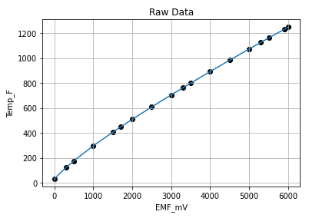
Remember the Thermocouple…
Linear-ish means
Robot will succeed-ish
Component will age over time so it would be nice to be able to collect and retrain automatically

Slide 8

Problem 2: Your input variables aren’t independent
Our diagrams describe how the code calculates
These assume that $x_{1}$ is independent of $x_{2}$, etc.
Example: Friction INSERT DIAG 3
I might think I can estimate friction based on weight and temperature

Slide 9
How to Fix it
INSERT DIAG 4
Almost Works
INSERT DIAG 5
More of a chance of working

Slide 10
And there we just invented…
Neural Networks
Of course, we didn’t. Here a great historical overview
https://www.tutorialspoint.com/artificial_neural_network/artificial_neural_network_quick_guide.htm#
Biological background
Different structures- feedforward most common
Training Heuristics
Backpropagation and infinite variations
All of these are GUESSES and STUFF TO TRY- “heuristics”
TONS of mathematical theory used to described how it all “might or might not” work

Slide 11
Back into code, then…
The ANN examples for the Thermocouple problem…
https://github.com/nedlecky/CSC485B/blob/main/CSC485_112_ThermocoupleMLP.ipynb
Eventually, with some significant hyperparameter experimentation, we get something that looks pretty solid

Slide 12

A little harder?
How about Pythagorean Theorem?
hypotenuse
side2
side1
Try a 2-input, 3-output version
$hypotenuse= \sqrt{{side1}^{2}+ {side2}^{2}}$
$perimeter=side1+side2+perimeter$
$area= \frac{1}{2}side1∗side2$

Slide 13
Linear Doesn’t work so well…
Take a look at my attempts!
https://github.com/nedlecky/CSC485B/blob/main/CSC485_120_Pythagoras.ipynb
It seems to work best only near where it’s trained
We can augment the input (PolynomialFeatures) to feed the squares of side1 and side2 in directly
But how in the world could we expect this to be able to extract a square root on the output??
INSERT DIAG 6

Slide 14

So the MLP would work??
What could possibly go wrong?
Well, we can go through the motions, but…
MLPs have no idea how to extract square root, either!!
Watch me struggle…
https://github.com/nedlecky/CSC485B/blob/main/CSC485_121_PythagorasMLP.ipynb
The lesson is to apply the neural network to the simplest possible problems that it is actually likely to be able to solve
Then you find it trains quickly and doesn’t need to be very big

Slide 15
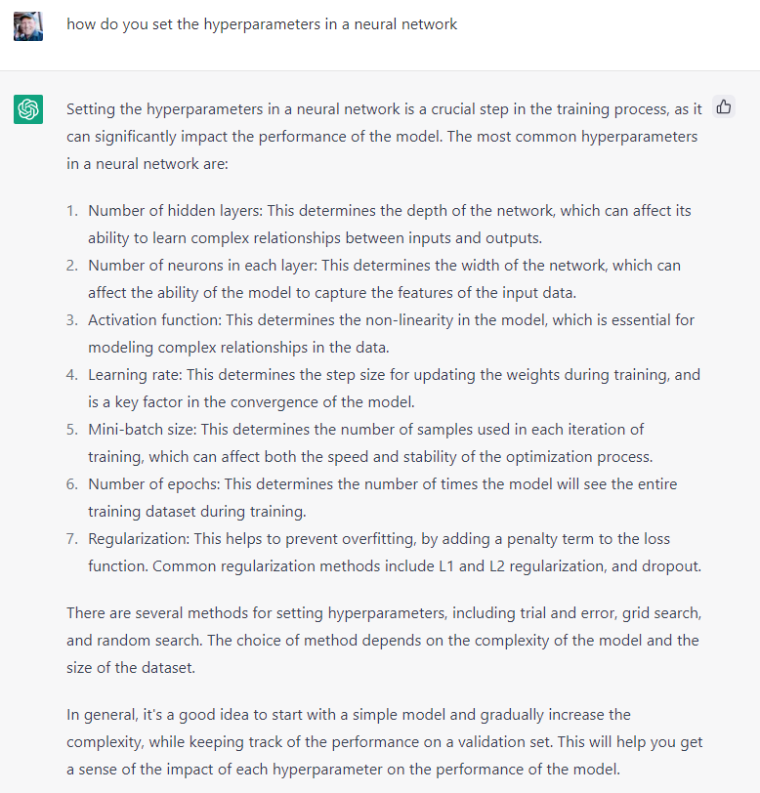
How Do You Set All the Hyperparameters?

Slide 16
What WOULD work?
Well, we know based on physics that the hypotenuse calc really cares about the squares of the input sides
And we know perimeter cares about the hypotenuse but area does not
So it seems to me…….

Slide 17
A Potential Architecture
You try it as Homework 2
side1
side2
side1^2
side2^2
WHEN you can do this THEN you will be able to use ANNs or any other ML tool for any size of regression problem in any application you ever write.
You will know how to use ML approaches to regression in real-world applications.
VERY SMALL
MLP
hypotenuse^2
area
y=sqrt(x)
hypotenuse^2
hypotenuse
side1
side2
hypotenuse
VERY SMALL MLP
perimeter

Slide 18
Homework 2 Details
sklearn.pipeline
Build your “Pythagoras dataset” to include 400 random triangles with sizes from 2cm to 2000cm on each side
Split it into training and test portions using sklearn.model_selection.train_test_split
Scale using std_scaler and figure out how to use a sklearn.pipeline so you don’t have to keep remembering to scale all of your Xs
Get your super simple MLPs running as suggested on the previous slide- Success is: max error < 0.5cm on hypotenuse, < 1cm on perimeter, and < 1cm^2 on area
Now, make the data more “realistic” by adding small random errors to your dataset
Generate an exact dataset
Now make your training dataset by assuming there are small errors in side1 and side2 measurements
Does your same code work when run on the exact data?

Slide 19
Next
A more complex example from my time at Google and DeepMind
Brighton Beach Lab
A regression problem that has subtle but significant nonlinearities and dependencies between seemingly-independent variables
https://sites.google.com/lecky.com/brighton-beach-lab/home

